Slide 1
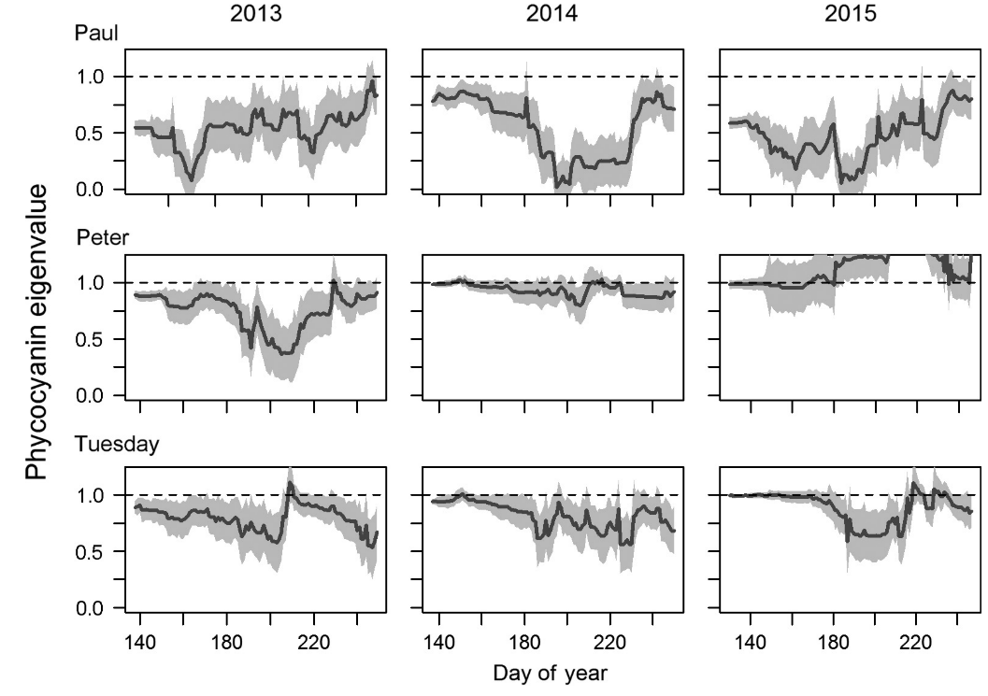
Online Dynamic Linear Modeling – Detecting critical transitions in ecological time series
Lunchinators – Feb. 27, 2020
Tyler J. Butts

Slide 2
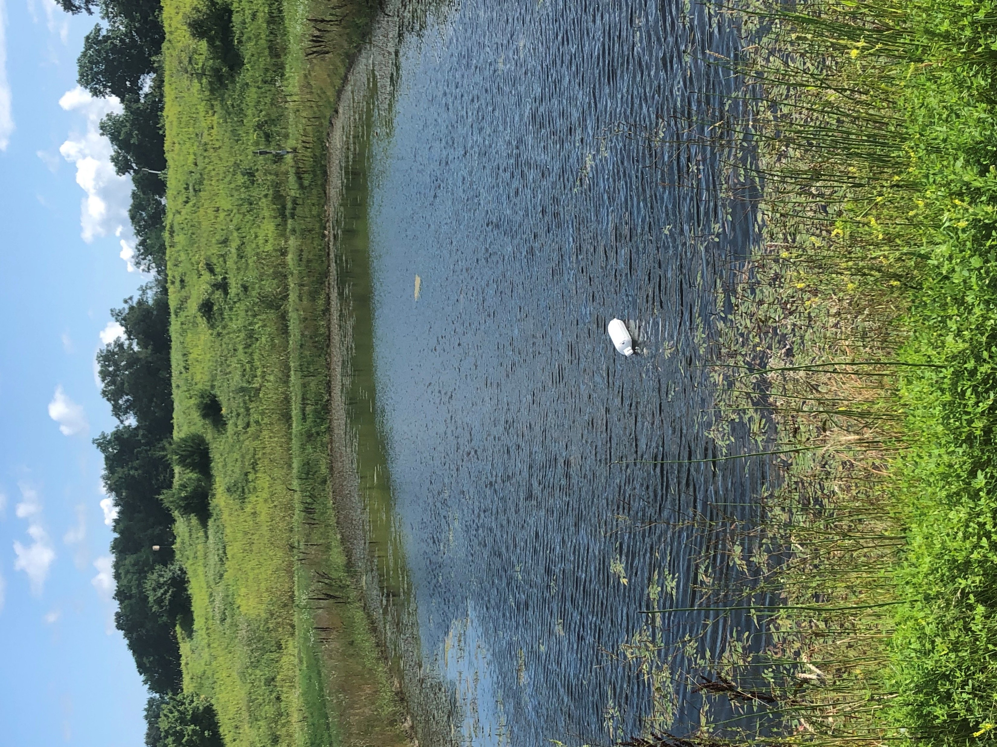
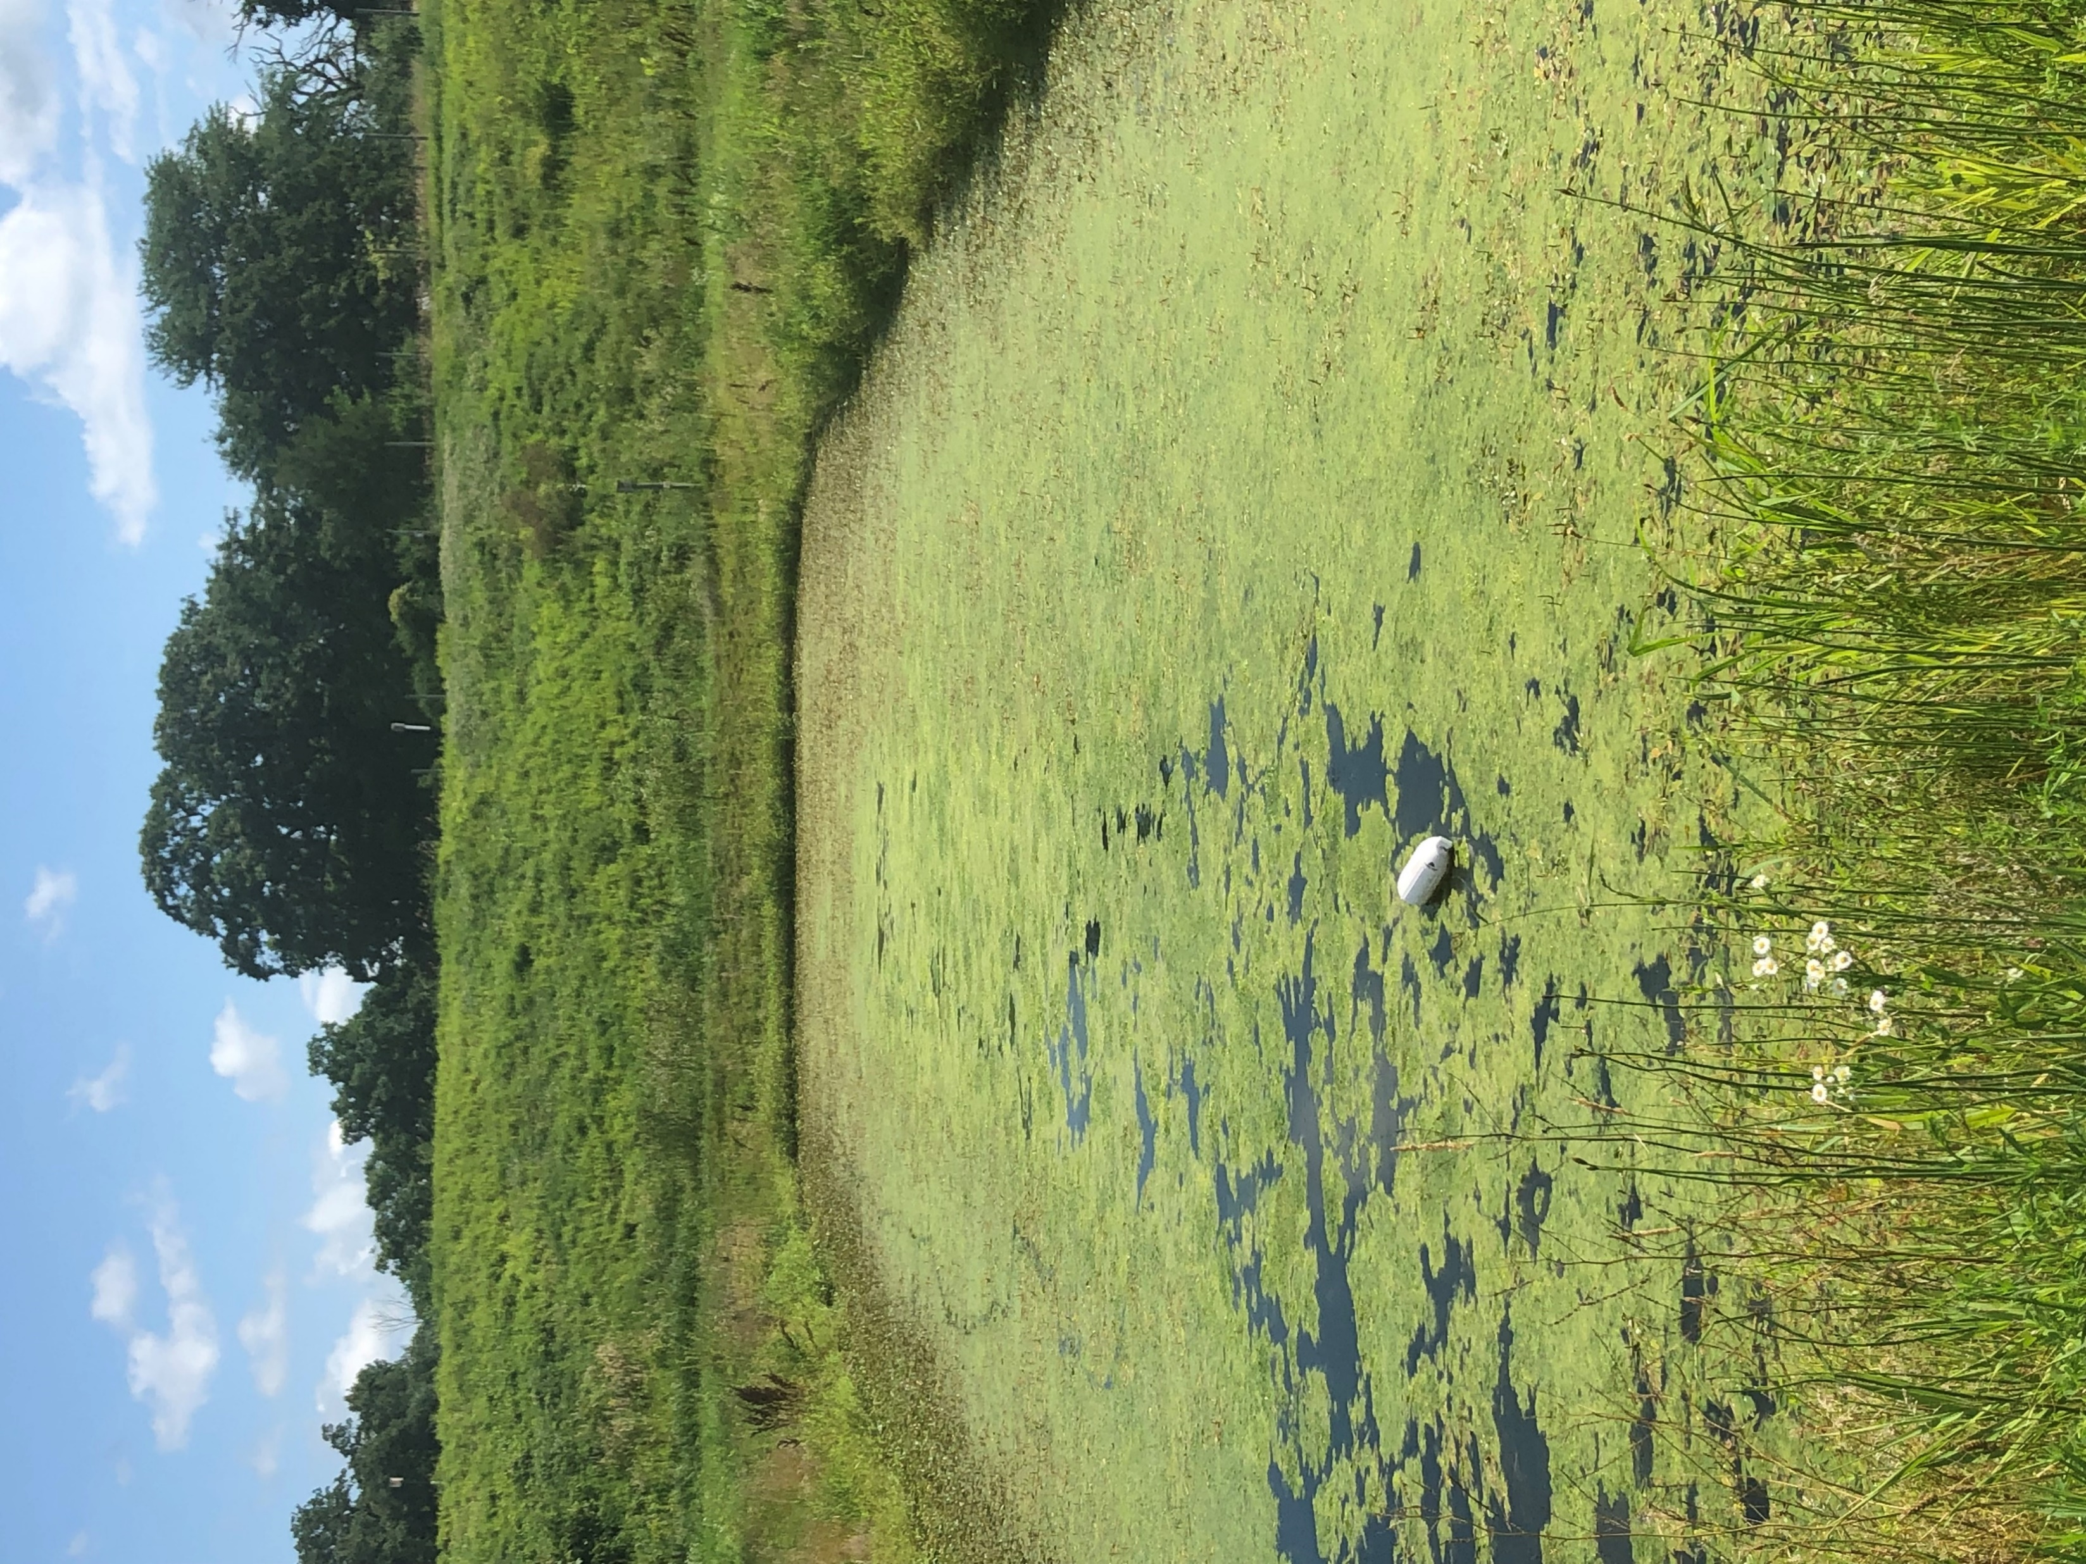
What is a critical transition?
Clear-water state
Turbid-water state
Notes:
But how do we know, quantitatively when a critical transition occurs?

Slide 3
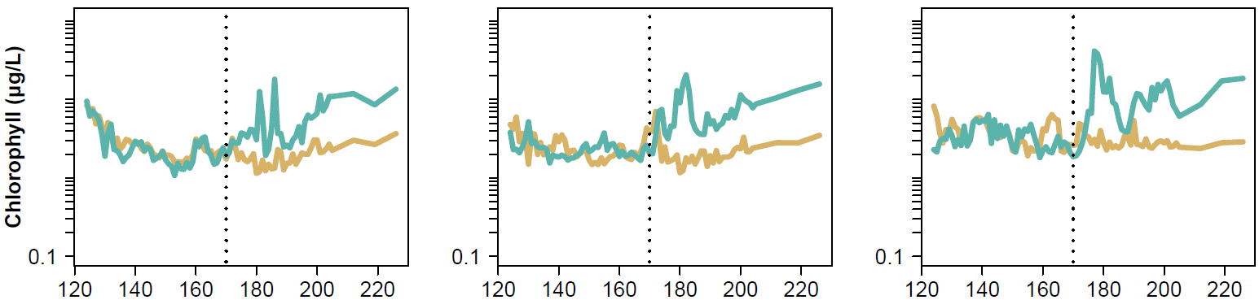
Online Dynamic Linear Modeling
High planktivore density
100
Method lets you pinpoint when a critical transition (i.e. regime shift) occurs in an ecosystem
Very useful for validating patterns observed in the data!
Was there a regime shift in this data?
10
Algal biomass (ug/L)
1
Day of Year
(Julian Calendar)
Wilkinson et al. 2018; Taranu et al. 2018

Slide 4

Constructing the DLM
Most methods that assess regime shifts are descriptive - four problems
Hard to statistically test hypotheses about changes in dynamics
Difficult to interpret changes in metrics when multiple simultaneous changes occur
No way to account for measurement error
Identifying regime shifts usually requires very long time-series
Ives & Dakos developed a locally linear autoregressive state-space model that can detect changes through time in stochastic dynamics
Ives and Dakos 2012

Slide 5
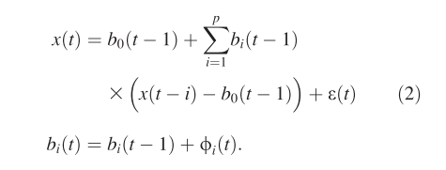
Constructing the DLM
X(t) is a standard autoregressive(p) model with coefficients expressed as function of time
B_{i}(t) allows the autoregression coefficients to vary as random walks, with rate dictated by the standard deviation of the time series
Select best lag time with AIC, calculate eigenvalues with the Box & Jenkins method

Slide 6
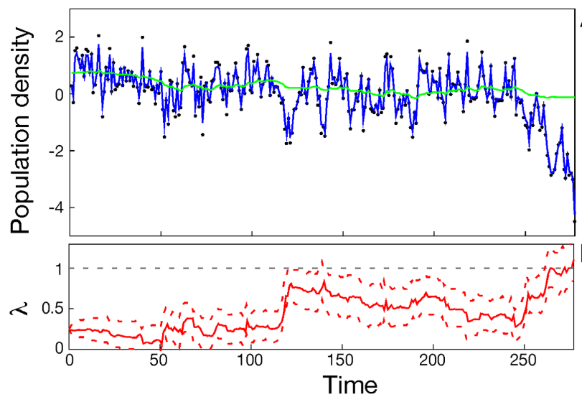
Interpreting the DLM
Carpenter & Brock 2006; Ives and Dakos 2012

Slide 7
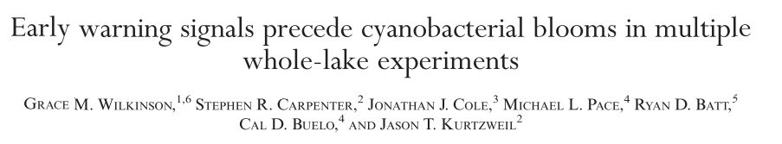
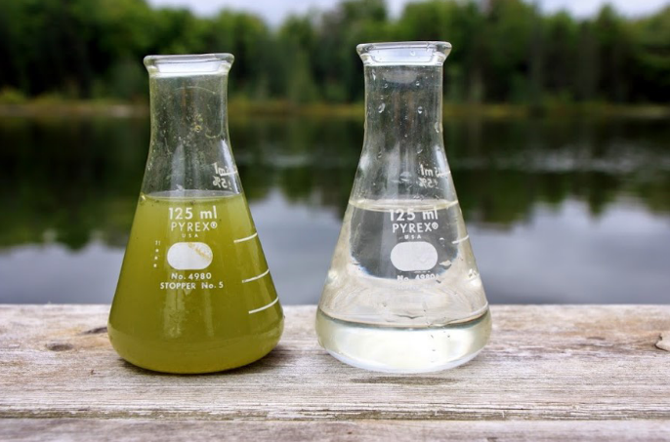
Application
Study: Assessed the utility of statistical early warning indicators by adding nutrients to two lakes over 3 years, with one reference system
DLM application: Corroborated evidence of a critical transition in manipulated lakes and a lack of a transition in the reference lake
Wilkinson et al. 2018

Slide 8
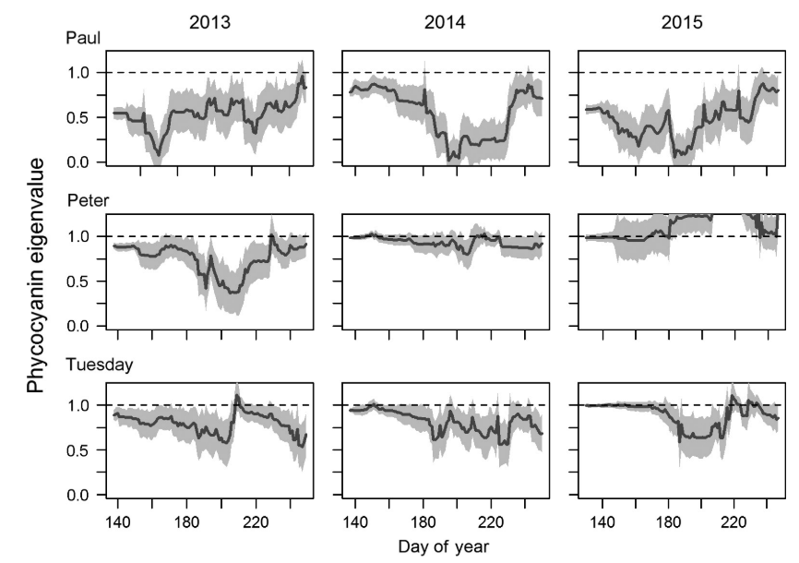
Wilkinson et al. 2018

Slide 9

Application

Slide 10
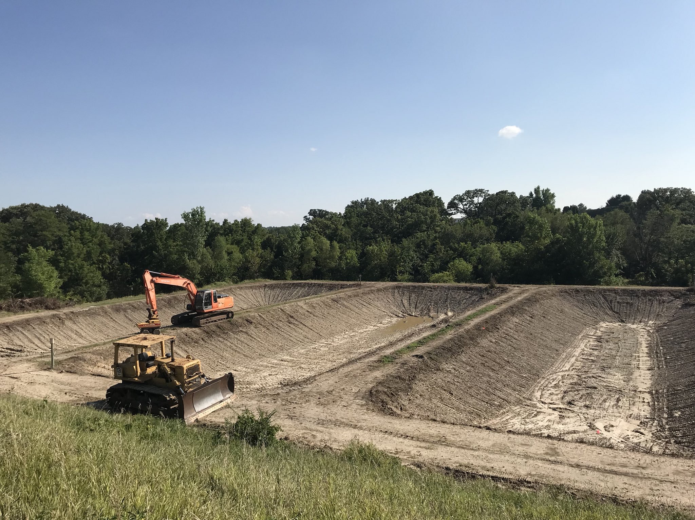
2 m

Slide 11
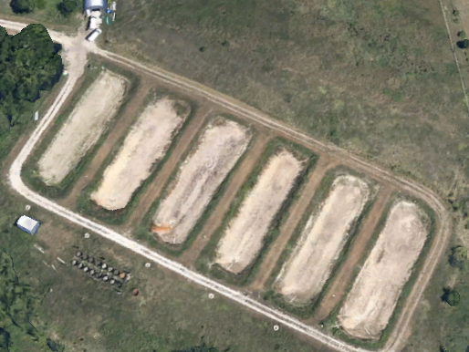
N
Reference
No fish
Pulse
Ambient
Harvested
No fish
Harvested
Ambient
10 m

Slide 12

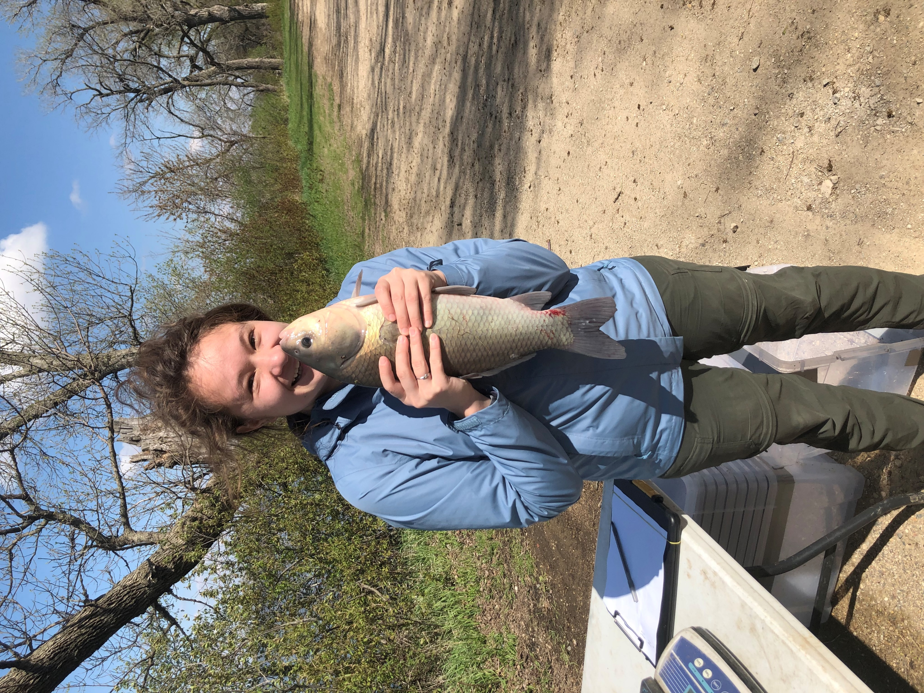
Notes:
And this is a bigmouth buffalo, which will be the buffalo I’ll be referring to for the rest of the talk. Now, going back to ecosystem function…

Slide 13
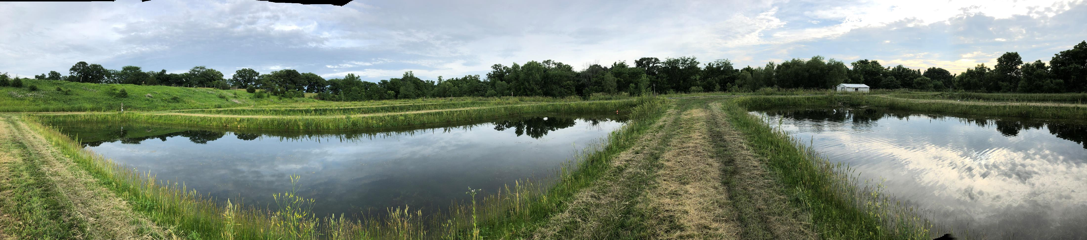
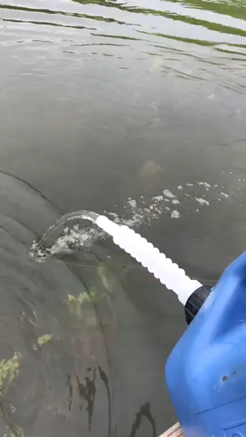
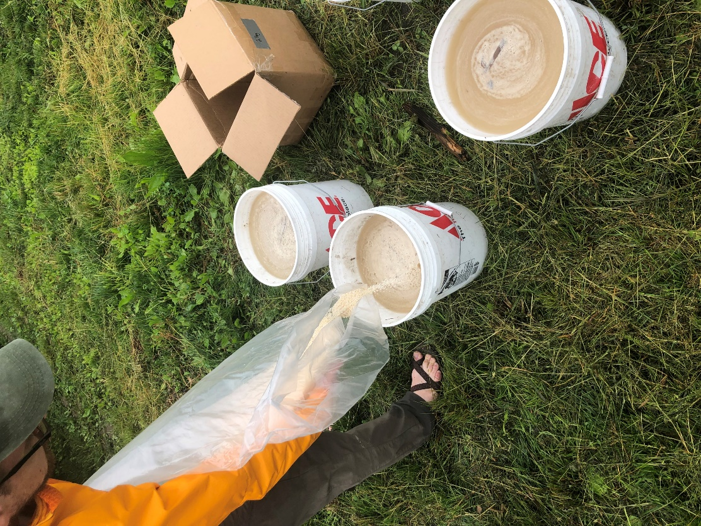
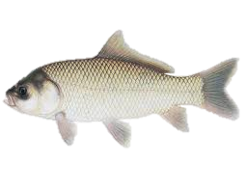
The perturbation
Simulated after a major storm event
5% P increase
25:1 N:P ratio
Reference
Pulsed ponds
Vanni et al. 2001; Lürling et al. 2018
Notes:
For that we simulated the nutrient loading from a major storm event. Did the pulse to one set of density treatments
Continued daily sampling for ~5 more weeks + 3 more weeks of weekly sampling
Let buffalo acclimate for ~6 weeks

Slide 14
Algal Biomass Response Affected by Food Web
No fish
Harvested
Ambient
100
100
100
10
10
10
1
1
1
Pulsed pond
Control pond
Day of Year
Notes:
Orient audience to graphs…Here we can see that the algal bloom occurred first in the ambient density pond, last in the pond with no buffalo, and in the middle fell the harvested pond…

Slide 15
Algal Biomass Response Affected by Food Web
No fish
Harvested
Ambient
100
17 days, 17.2 µg/L
100
12 days, 19.5 µg/L
100
8 days, 40.6 µg/L
10
10
10
1
1
1
Pulsed pond
Control pond
Day of Year
Notes:
Orient audience to graphs…Here we can see that the algal bloom occurred first in the ambient density pond, last in the pond with no buffalo, and in the middle fell the harvested pond…

Slide 16
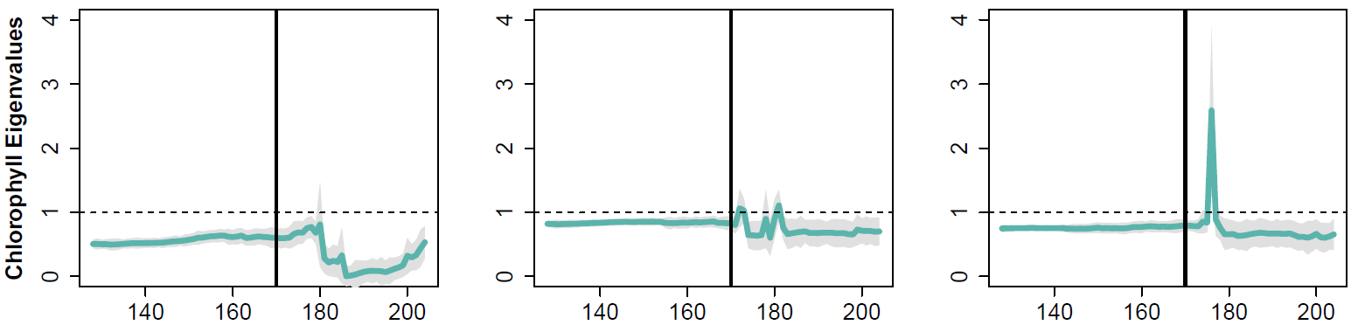
Algal Biomass Response Affected by Food Web
No fish
Harvested
Ambient
100
17 days, 17.2 µg/L
100
12 days, 19.5 µg/L
100
8 days, 40.6 µg/L
10
10
10
1
1
1
Pulsed pond
Control pond
Day of Year
Online Dynamic Linear Modeling – Did a regime shift occur?
Regime Shift!
Flickering!
Day of Year
Notes:
Orient audience to graphs…Here we can see that the algal bloom occurred first in the ambient density pond, last in the pond with no buffalo, and in the middle fell the harvested pond…

